Slide 1
The Fourier Theory
Jean Baptiste Fourier (19th Century French Mathematician) proved:
Any periodic waveform can be expressed as sum of one or more sine waves
Any signal can be described either in terms of amplitude versus time (signal) or energy versus frequency (spectrum)
“Time Domain” and “Frequency Domain”

Slide 2
The Discrete Fourier Transform (DFT)
All periodic signals are presumed to be infinitely long
The Discrete Fourier Transform takes a finite duration (window) of a time domain signal and converts it into a spectrum
Basic approach: an iterative process of finding the amplitudes and phases of all harmonics of fundamental (1/window)

Slide 3
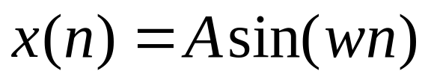
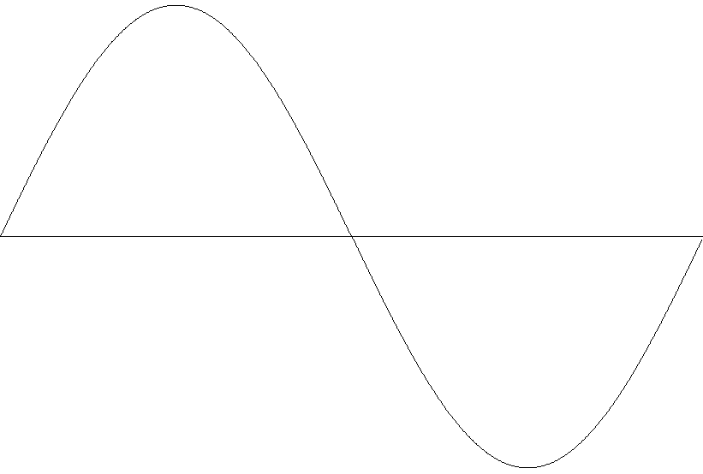
Basic Concepts
Let x(n) be signal containing 8 equally spaced points
on a single complete cycle of a sine wave of amp A:

Slide 4
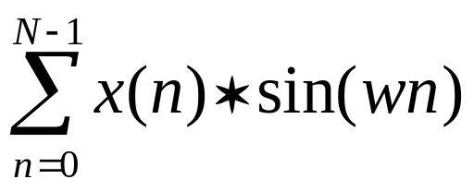
Finding The Average Amplitude
Simply averaging the 8 values of x(n) tells us nothing,
because summing the negative and positive halves of
any periodic waveform will always equal zero.
However, if we first multiply the sine wave by another
sine wave of the same frequency, and then sum, we can
get some useful values, e.g.

Slide 5
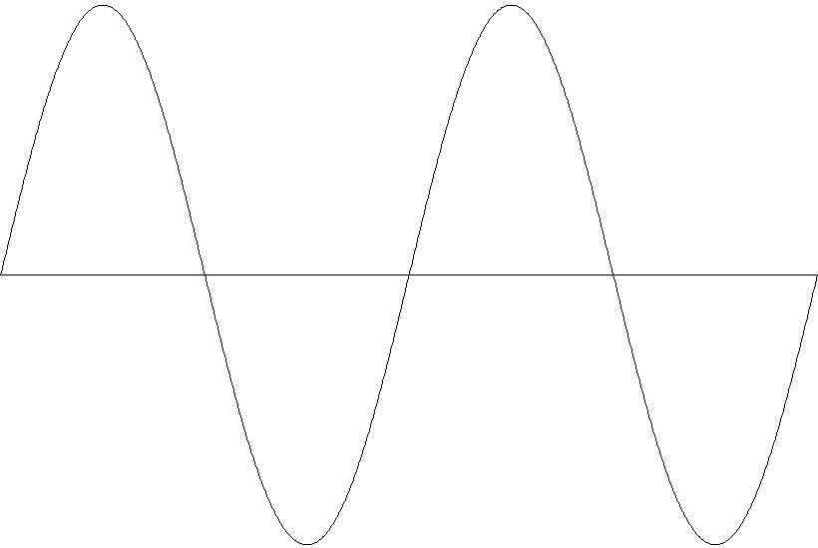
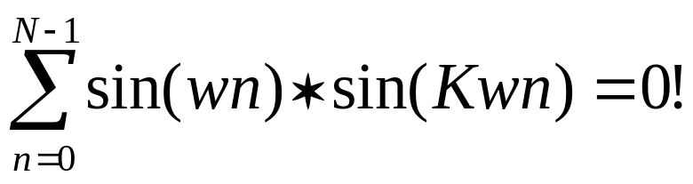
Other Harmonics Cancelled
All integer multiples of this frequency will be cancelled!
Why? Because (assuming that they are in phase), all integer
multiples of the fundamental will be symmetrical around the
midpoint. Multiplying by sin(wn) inverts the second half.

Slide 6
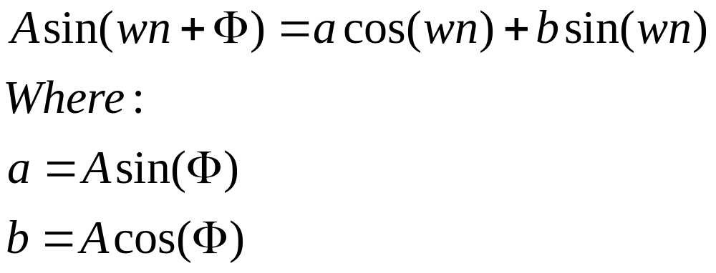
What About Phase?
However, a sinusoid of arbitrary phase and amplitude
can also be represented as:

Slide 7
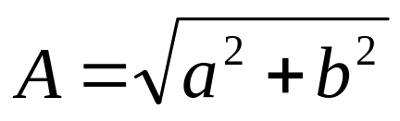
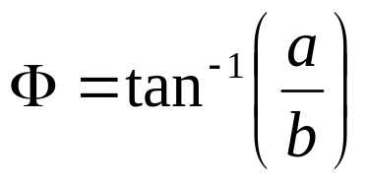
Quick Summary
By multiplying by both sin(wn) and cos(wn), it is possible to extract both amplitude & phase:
By multiplying through by successively higher harmonics and summing the results, the energy and phase of each harmonic can be found
Inverting the process (Inverse DFT) will exactly reproduce the time domain waveform
and

Slide 8
Fast Fourier Transform (FFT)
The FFT is an highly efficient computer implementation of the DFT, developed in the mid-1960s at IBM (Cooley and Tukey)
The DFT is rarely used today, because the FFT produces identical results, but executes much faster (by several orders of magnitude)
The only limitation is that the size of the analysis window must be a power of 2.

Slide 9
Short Time Fourier Transform
For some applications, it is useful to take multiple FFTs of an audio signal at some time interval
These are sometimes referred to as STFTs, or Short Time Fourier Transforms
The individual FFTs are computed from a “windowed” portion of the audio signal
The length (number of samples or “points”) in the analysis window determines the number of frequency “bins” in the output (only ½ are used)

Slide 10

STFTs Continued
The SR and the length of the analysis window in samples determine the frequency resolution :
There is always a trade/off between frequency and time resolution
The longer the analysis window, the greater the frequency resolution
The shorter the analysis window, the finer the temporal resolution

Slide 11
The Freq Vs Time Tradeoff
The window length also determines the lowest possible frequency detected (1/dur)
At 44.1K, an FFT window size of 2048 would track frequencies down to 21.5Hz, but have a time increment of almost .05 sec
By overlapping and adding analysis frames, however, a good compromise can be found
One application of STFTs is in analysis/resynthesis

Slide 12
Csound Analysis Utilities
Csound provides a number of utilities that can either be executed as stand-alone programs or invoked via the command line option -U
A number of Csound’s most interesting unit generators require data generated by one of these utilities
In most cases, the utilities operate on standard (integer) audio files (WAV or AIFF)
Some utilities require the user to set critical parameters (such as analysis window size, hop size, etc) that directly affect the results (see the Csound manual)

Slide 13
The Phase Vocoder
Developed by Portnoff (‘76); introduced by J. A. Moorer (‘78); implemented by Mark Dolson (’83)
Similar to STFT technique, but provides a method of accurately tracking the deviation from the center frequency of each analysis bin
Like FFT, PV can be viewed as a bank of band-pass filters. The more filters used, the finer the frequency resolution, but the slower the execution, and the coarser the temporal resolution.

Slide 14
Uses of the Phase Vocoder
Best overall method of performing time stretching, pitch shifting, cross synthesis, and spectral mutation
Reading:
  Boulanger: Chapter 28 on Phase Vocoder by Richard Karpen
  Dodge: pp. 244 - 257
  Roads: pp. 566 - 575

Slide 15
Syntax of pvanal
csound -U pvanal [flags] infilename outfilename
infilename – audio file to be analyzed
outfilename – output file name (usually pvoc.nnn)
Flags:
-s rate – sampling rate of the audio input file.
-c channel – channel number sought. Default is all channels.
-b begin – beginning time (in seconds). Default is 0.0
-d duration – duration (in seconds). Default is to the end of the file.
[continued next slide]

Slide 16
More on pvanal
Additional Flags:
-n frmsiz – STFT frame size, the number of samples in each analysis frame.
Must be a power of two, in the range 16 to 16384
-w windfact – Window overlap factor. This controls the number of Fourier
transform frames per second. The default value is 4.
Do not use this flag with -h.
-h hopsize – STFT frame offset. Converse of above, specifying the increment
in samples between successive frames of analysis.
Do not use with -w.

Slide 17
Syntax of pvoc
ar pvoc ktimpnt, kfmod, ifilcod[, ispecwp]
ktimpnt – time pointer into analysis file (in seconds)
kfmod – pitch modification factor (1 = no change)
ifilcod – pvoc.# or “filename”
ispecwp (optional) – if non-zero, attempts to preserve the spectral envelope while its frequency content is varied by kfmod. The default value is zero

